Slide 1
Crumple and shoot -All credit to Ms.L

Slide 2
Rules
-Every group (approx. 4-5) gets a whiteboard, marker and eraser.
- Choose an appropriate team name or I’ll number you off
-Choose a 1pt, 2pt, 3pt and potentially a 5pt line to shoot your crumpled paper from into the waste basket.
- The question will show on the projector, you have 30sec-1min (possibly more) depending on the question
- Respect the ‘board up’ call and show all answers at the same time. No cheating!
- The groups that get it correct get to pick ONE person to come up and shoot from wherever they want
- If you get the ball/paper ball in you get the point(s). If not, sit down and get no points.
- Team with the most points win
Absolutely no malicious sledging or interfering with the person throwing (points taken off if this happens)
Have fun!

Slide 3
Question 1
Which of the following is the largest number?
A) 16464 B) 14664 C) 16644 D) 16446

Slide 4
c) 16644

Slide 5
Question 2
I think of a number
I double it
I add 4
I multiply it by 6
My answer is 72
What was the number?

Slide 6
The number was 4.

Slide 7
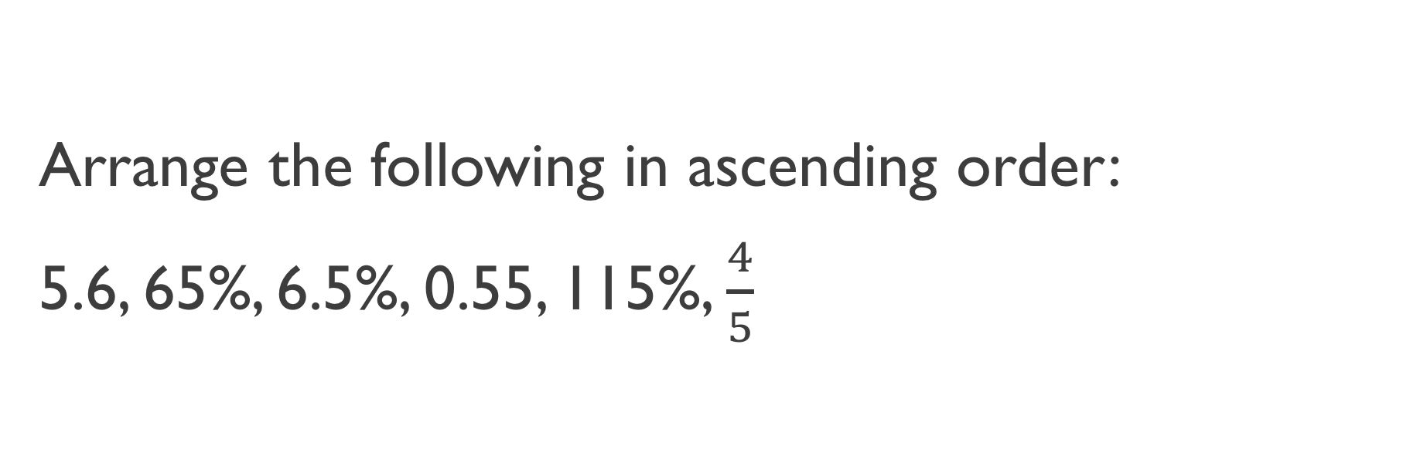
Question 3
Arrange the following in ascending order:
5.6, 65%, 6.5%, 0.55, 115%, $\frac{4}{5}$

Slide 8
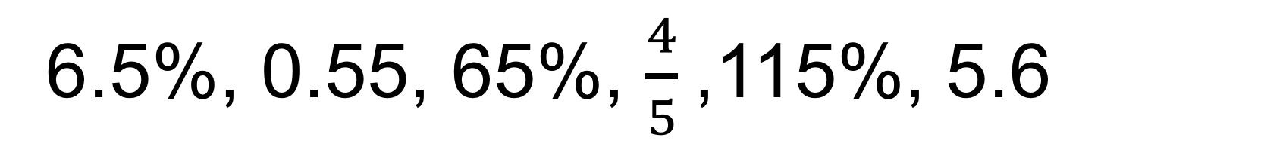
6.5%, 0.55, 65%, $\frac{4}{5}$,115%, 5.6

Slide 9
Question 4
What is 10% of $350?

Slide 10
$35

Slide 11
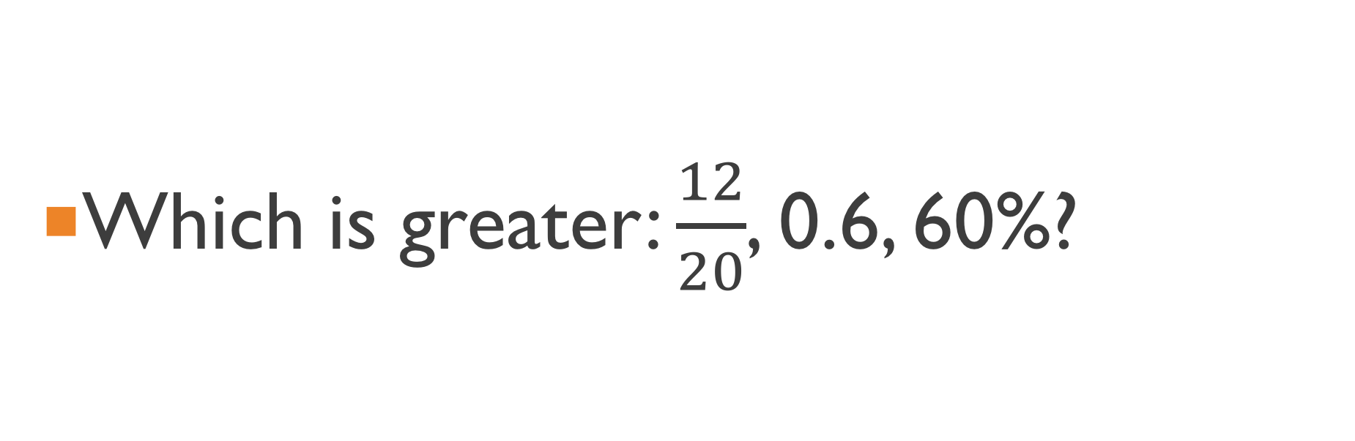
Question 5
Which is greater: $\frac{12}{20}$, 0.6, 60%?

Slide 12
None. They are all equal

Slide 13
Question 6
What is the word for the place value of the 7 in the following:
0.1274

Slide 14
thousandth

Slide 15
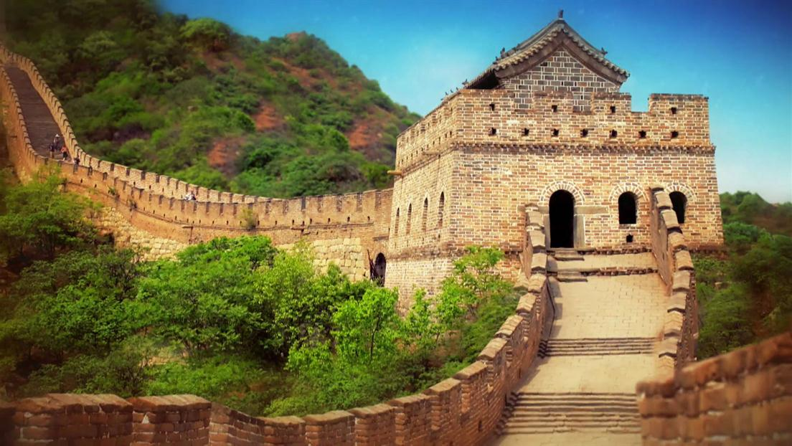
Question 6
What is this called?
Great Wall of China

Slide 16

Question 7
What is 6.85 $÷5 ?$
1.37

Slide 17
Question 8
Estimate (without a calculator) 15.2 x 19
150
250
300
c)300

Slide 18
Question 11
Estimate how many 20g Tim Tams are in a 250g pack:
15
10
20
12
d) 12

Slide 19
Question 14
An octopus can fit though any hole larger than its what?
Beak

Slide 20
Question 13
Estimate the following:
302 + 494 + 155
750
1200
950
c) 950

Slide 21
Question 16
Round the following to 2 decimal places:
6.978
6.98

Slide 22
Question 16
Each of a Rubiks cubes six faces is covered by how many stickers?
9

Slide 23
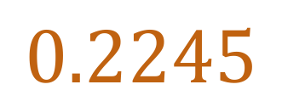
Question 17
Write the following as a decimal:
22.45%
$$0.2245$$

Slide 24
Question 18
A pair of shoes cost $220. Their value suddenly increases by 20%. How much do they cost now?:
$264

Slide 25
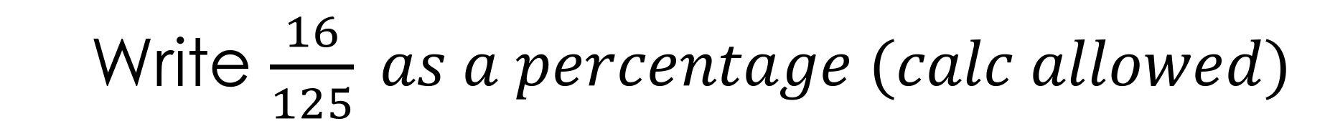
Question 19
Write $\frac{16}{125} as a percentage (calc allowed)$
12.8%

Slide 26
Question 21
What was the name of the human boy in the Jungle Book?
Mowgli

Slide 27
Question 22
37% of $78
$28.86

Slide 28
Question 22
$400 has a discount of 25%. What is the new price?
$300

Slide 29
Question 18
Pepito earns $18 an hour on weekdays and time and a half on weekends. If he worked a 12hr shift on Saturday, how much did he earn?
$216

Slide 30
Question 19
Ms. L needs to drive 85 km to pick up Mr. Summers. She drives 14 km before stopping for gas, then another 22 km before grabbing coffee. How much farther does she has to travel?
49km and Mr. Summers needs to buy his own car

Slide 31
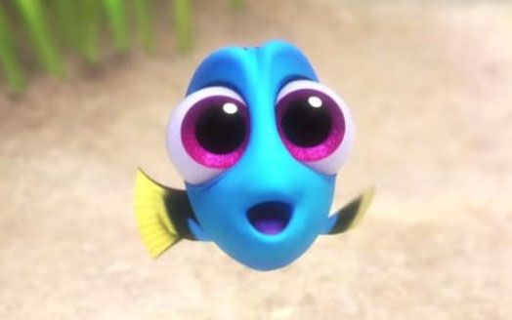
BONUS
Who is this?

Slide 32
Baby Dory

